Slide 1

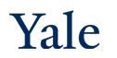
Deep Learning Theory and Applications Regularization
CPSC/AMTH 663

Slide 2
Outline
Overfitting
Stability
Regularization
Regularization techniques
L1/L2 Regularization
Dropout
Augmenting the training data
Noise robustness
Tangent Propogation

Slide 3
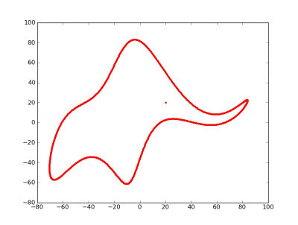
Free parameters
https://www.johndcook.com/blog/2011/06/21/how-to-fit-an-elephant/
With four parameters I can fit an elephant, and with five I can make him wiggle his trunk. -- von Neumann.
Notes:
It turns out you can fit an elephant with 4 parameters if they’re complex

Slide 4
Free parameters
Models with large # of free parameters can describe a wide range of phenomena
Agreement with the data doesn’t guarantee a good model
Model may just be able to describe data set of a given size
I.e., model may work well for existing data but fail to generalize
The true test: can the model make accurate predictions on new data?

Slide 5
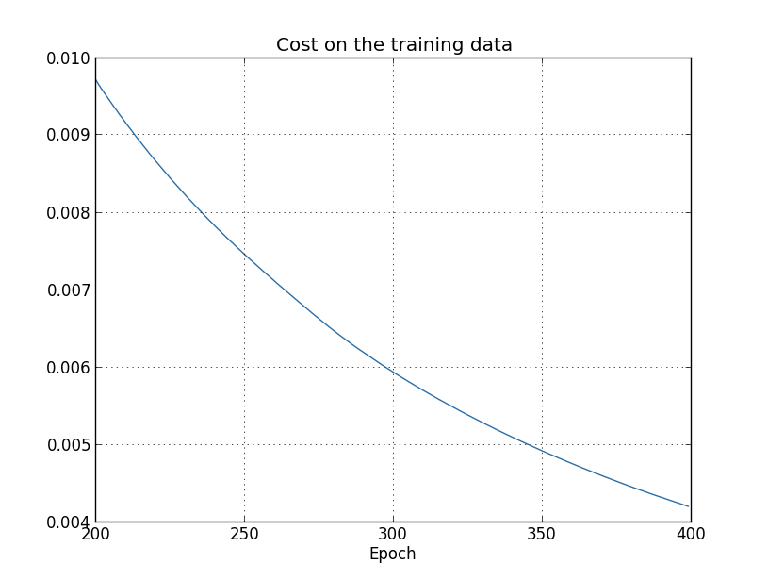
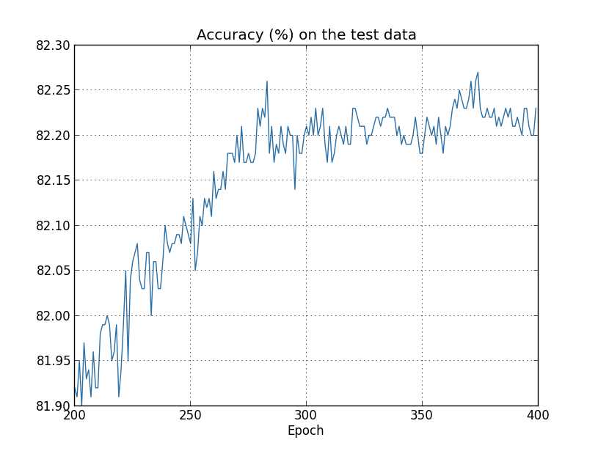
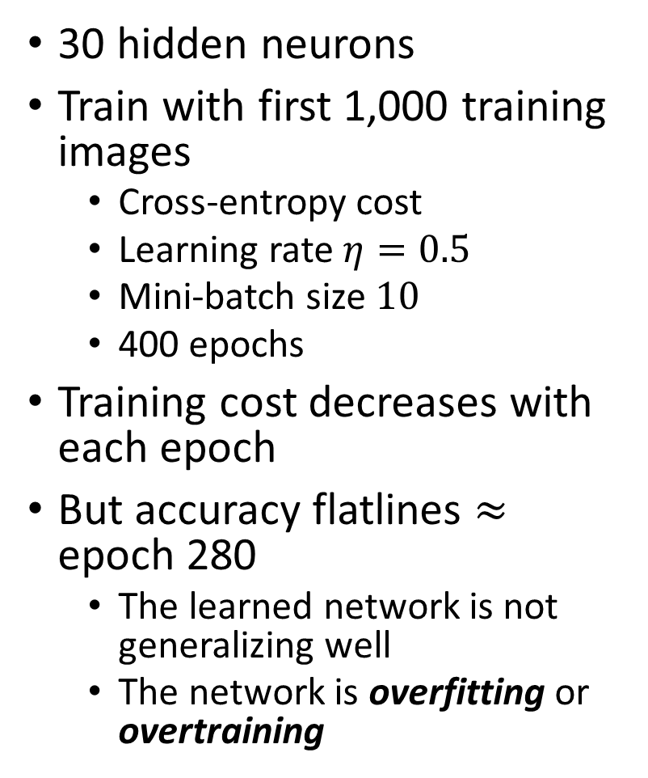
MNIST recognition revisited
30 hidden neurons
Train with first 1,000 training images
Cross-entropy cost
Learning rate $η=0.5$
Mini-batch size $10$
400 epochs
Training cost decreases with each epoch
But accuracy flatlines $≈$ epoch 280
The learned network is not generalizing well
The network is overfitting or overtraining
Notes:
The cost decreases as we expect which is good. But the classification accuracy on the test data flatlines around 82.2% with some variations

Slide 6
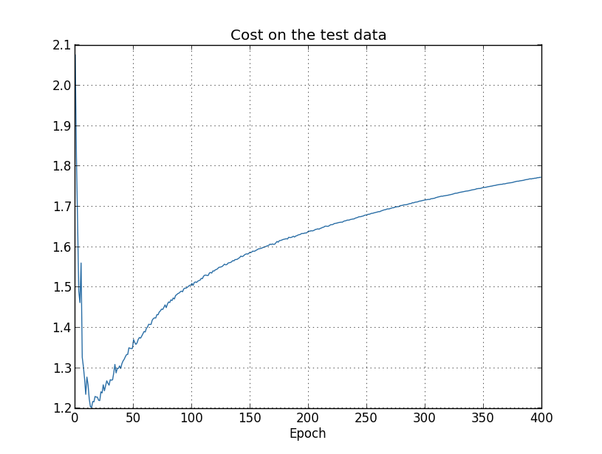
Cost vs classification accuracy
We were comparing the cost on the training data to the classification accuracy on the test data
Is this an apples to oranges comparison?
Should we compare the cost in both cases or the accuracy in both cases?
Notes:
It ends up not mattering (note the different range in the x-axis). The cost on the test data improves until around epoch 15, after which it gets worse, suggesting overfitting.

Slide 7
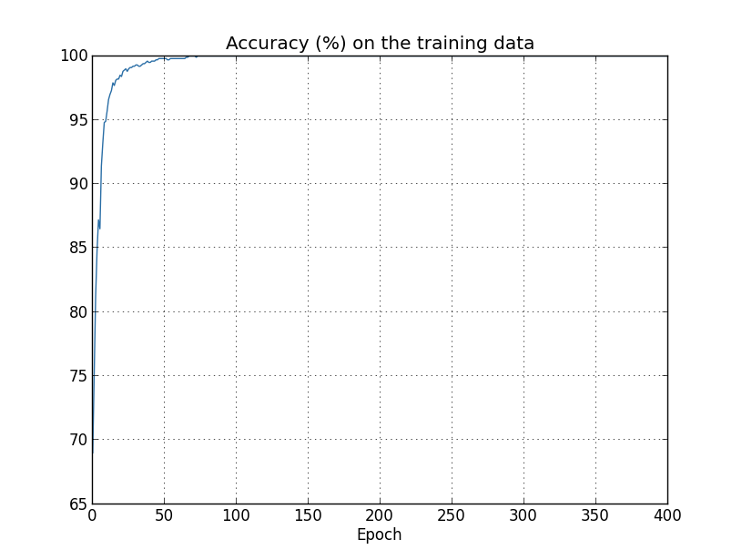
Cost vs classification accuracy
Comparing the accuracy also suggests overfitting
The network is learning the peculiarities of the training set
Notes:
The training accuracy goes all the way to 100%, suggesting that the network is learning

Slide 8
When does overfitting occur?
Epoch 15 or epoch 280?
The cost is a proxy for what we really care about: accuracy
So epoch 280 makes the most sense
Notes:
Have people vote

Slide 9
Stability improves overfitting
Adding or taking off a few inputs should not change the weights much
Solution must be stable to small inputs and input perturbations
SGD is naturally stable because it operates at a batch level, but does better with more training data
To increase stability with SGD, get more data so that no one input pulls weights too far
Another way is to stop before convergence so that the model doesn’t spend too much time working on the last few examples

Slide 10
Early stopping
One approach: track the test accuracy during training
Stop training if the test accuracy no longer improves
Caveat: this isn’t necessarily a sign of overfitting but stopping when this occurs will prevent overfitting
A variation: track the accuracy on a validation set
Stop training when we’re confident the validation accuracy has saturated
Requires some judgment as networks sometimes plateau before improving
Referred to as early stopping
Notes:
So it’s possible that in the earlier case we would have seen further improvement after 400 epochs

Slide 11
Implementing early stopping
Use a validation set instead of the test set to determine the number of epochs (and other hyper-parameters)
We’re likely to try many different choices for the hyper-parameters
If the hyper-parameters are set based on the test data, we may overfit to the test data
After setting the hyper-parameters with the validation set, we evaluate the final performance on the test set
This gives us confidence that the test set results are a true measure of how well our learned network generalizes

Slide 12
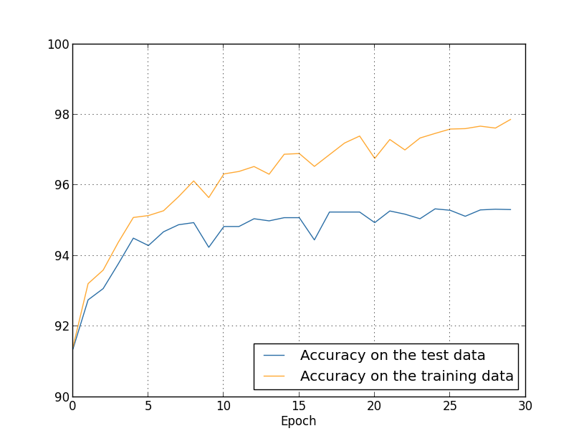
Handwritten digit recognition revisited
Were we overfitting when we used all 50,000 training images?
Some, but not nearly as much as before
Notes:
Same parameters as before: 30 neurons, 0.5 learning rate, mini-batch size of 10, 30 epochs
The accuracies are much closer than when we were using 1000 training images

Slide 13
A great way to prevent overfitting
Get more training data!
Notes:
Unfortunately, this isn’t always an option. So what else can we do?

Slide 14
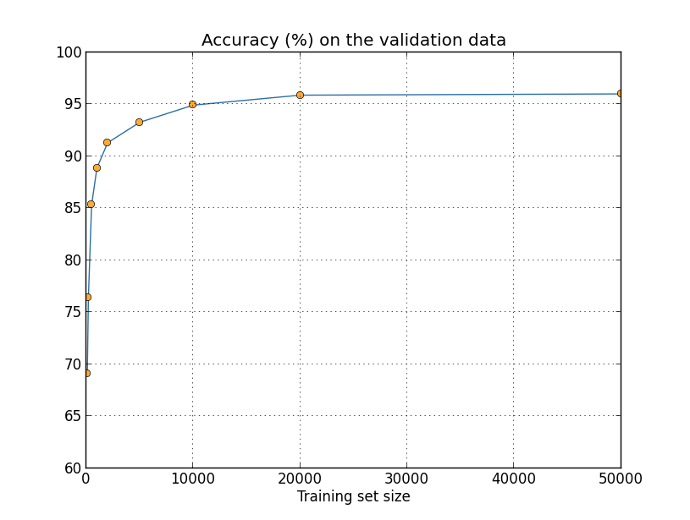
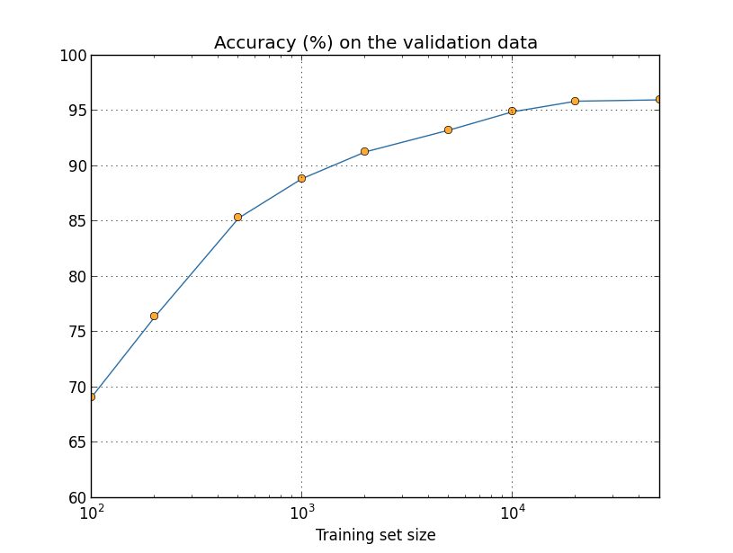
Artificially increasing the training data
Saw earlier that our MNIST classification accuracy decreased dramatically with only 1,000 training images
How does accuracy improve as a function of sample size?
Notes:
Learning rate $η=0.5$, 30 hidden nodes, mini-batch size 10, reg param $λ=5$ for full data, cross-entropy cost, 30 epochs for full data, more for less
As you can see, the performance improves quite a bit as we use more training data and we assume that increasing the data will improve the performance. This is especially true if we look at a log scale. So it seems if we could train on millions or billions of samples, we’d get better results.

Slide 15
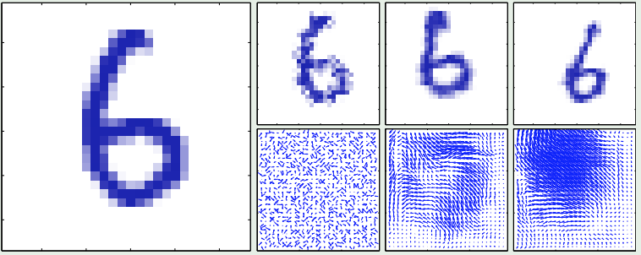
Input Augmentation
Artificially transform inputs in ways that you don’t want the neural network to care about
Does not change the label for classification

Slide 16
Artificially increasing the training data
MNIST results from Simard et al. (2003)
Feedforward network with 800 hidden neurons and cross-entropy cost function
Accuracy on standard dataset: 98.4%
Applied rotations and translations: 98.9%
Applied “elastic distortions” as well
Image distortion intended to emulate random oscillations in the hand muscles
Accuracy: 99.3%

Slide 17
Artificially increasing the training data
General principle: expand the training data by applying operations that reflect real-world variation
Example: speech recognition
Add background noise
Speed it up
Slow it down
Alternatively, could do preprocessing to remove these effects
May be more efficient in some cases

Slide 18
Noise robustness
Adding noise is a form of regularization
Add noise to the inputs
Can be viewed as increasing the training data
Add noise to the hidden layers
Add noise to the weights
Adding noise at the output layer
Can reflect noise or mistakes in the labels
Can be modeled explicitly in the cost function
Dropout is a form of multiplicative noise

Slide 19
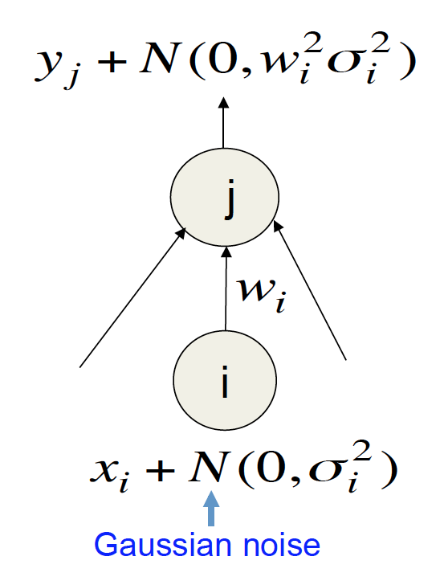
Input Gaussian Noise
Minimizing squared error minimizes square weights

Slide 20
Regularization
Traditionally regularizations decrease capacity of the model
But neural networks have super high capacity!

Slide 21
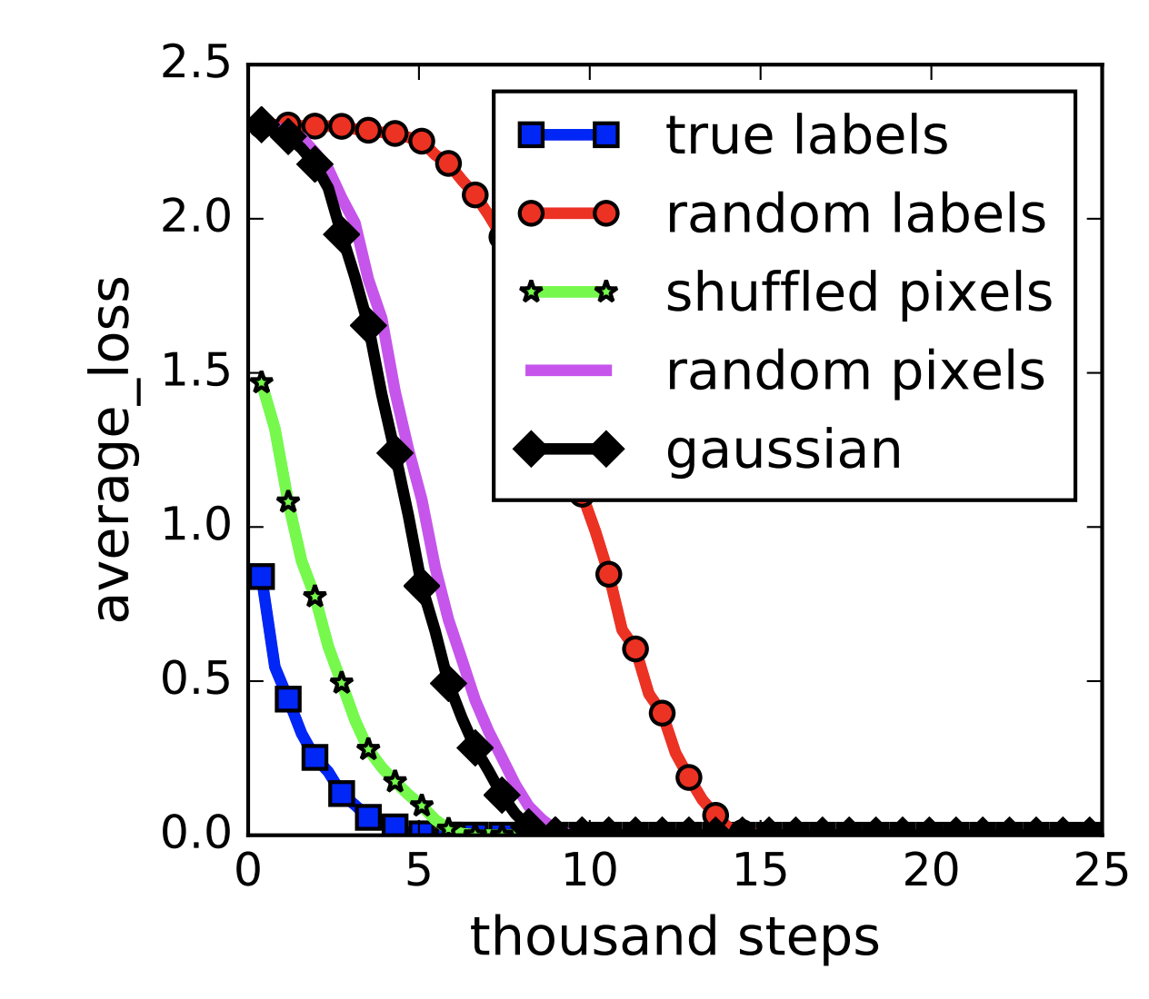
Memorization = fitting to random data
[Zhang et al. ICLR 2017]

Slide 22
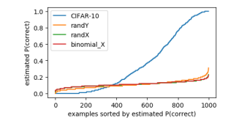
Real data generalizes better
[Arpit et al 2017]

Slide 23
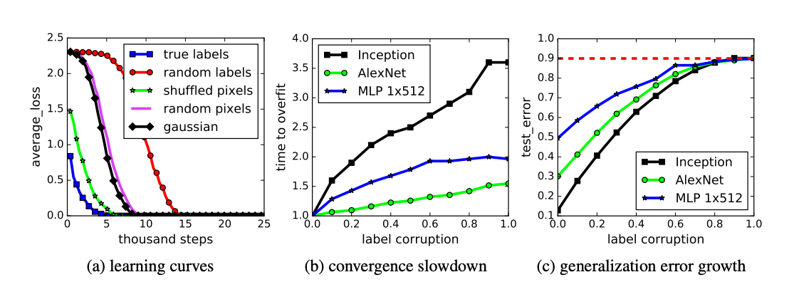
Overfitting does not generalize

Slide 24
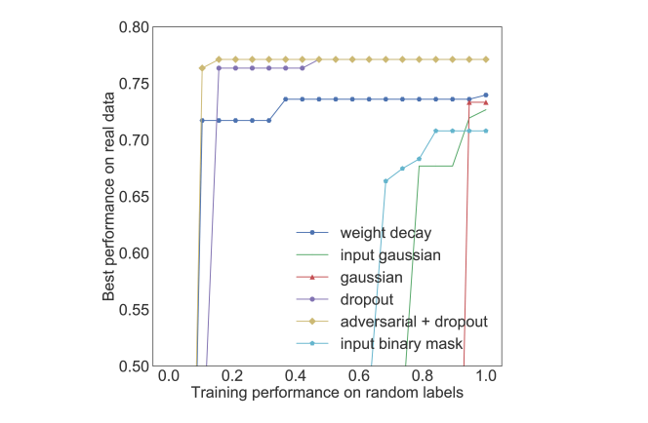
Regularizations do not have an effect on capacity !
[Arpit et al. 2017[
They affect the ability to generalize but not on the ability model capacity

Slide 25
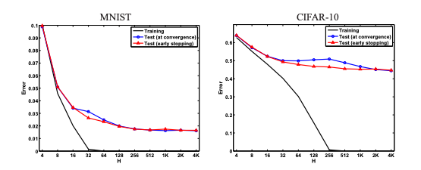
Inductive bias
[ Neyshabur et al 2015]
An inductive bias restricts or encourages predictors to be “simple” in some way, which in turn allows for generalization
The success of learning then depends on how well the inductive bias captures reality
The inductive bias is not the size of the neural network, what could it be?

Slide 26
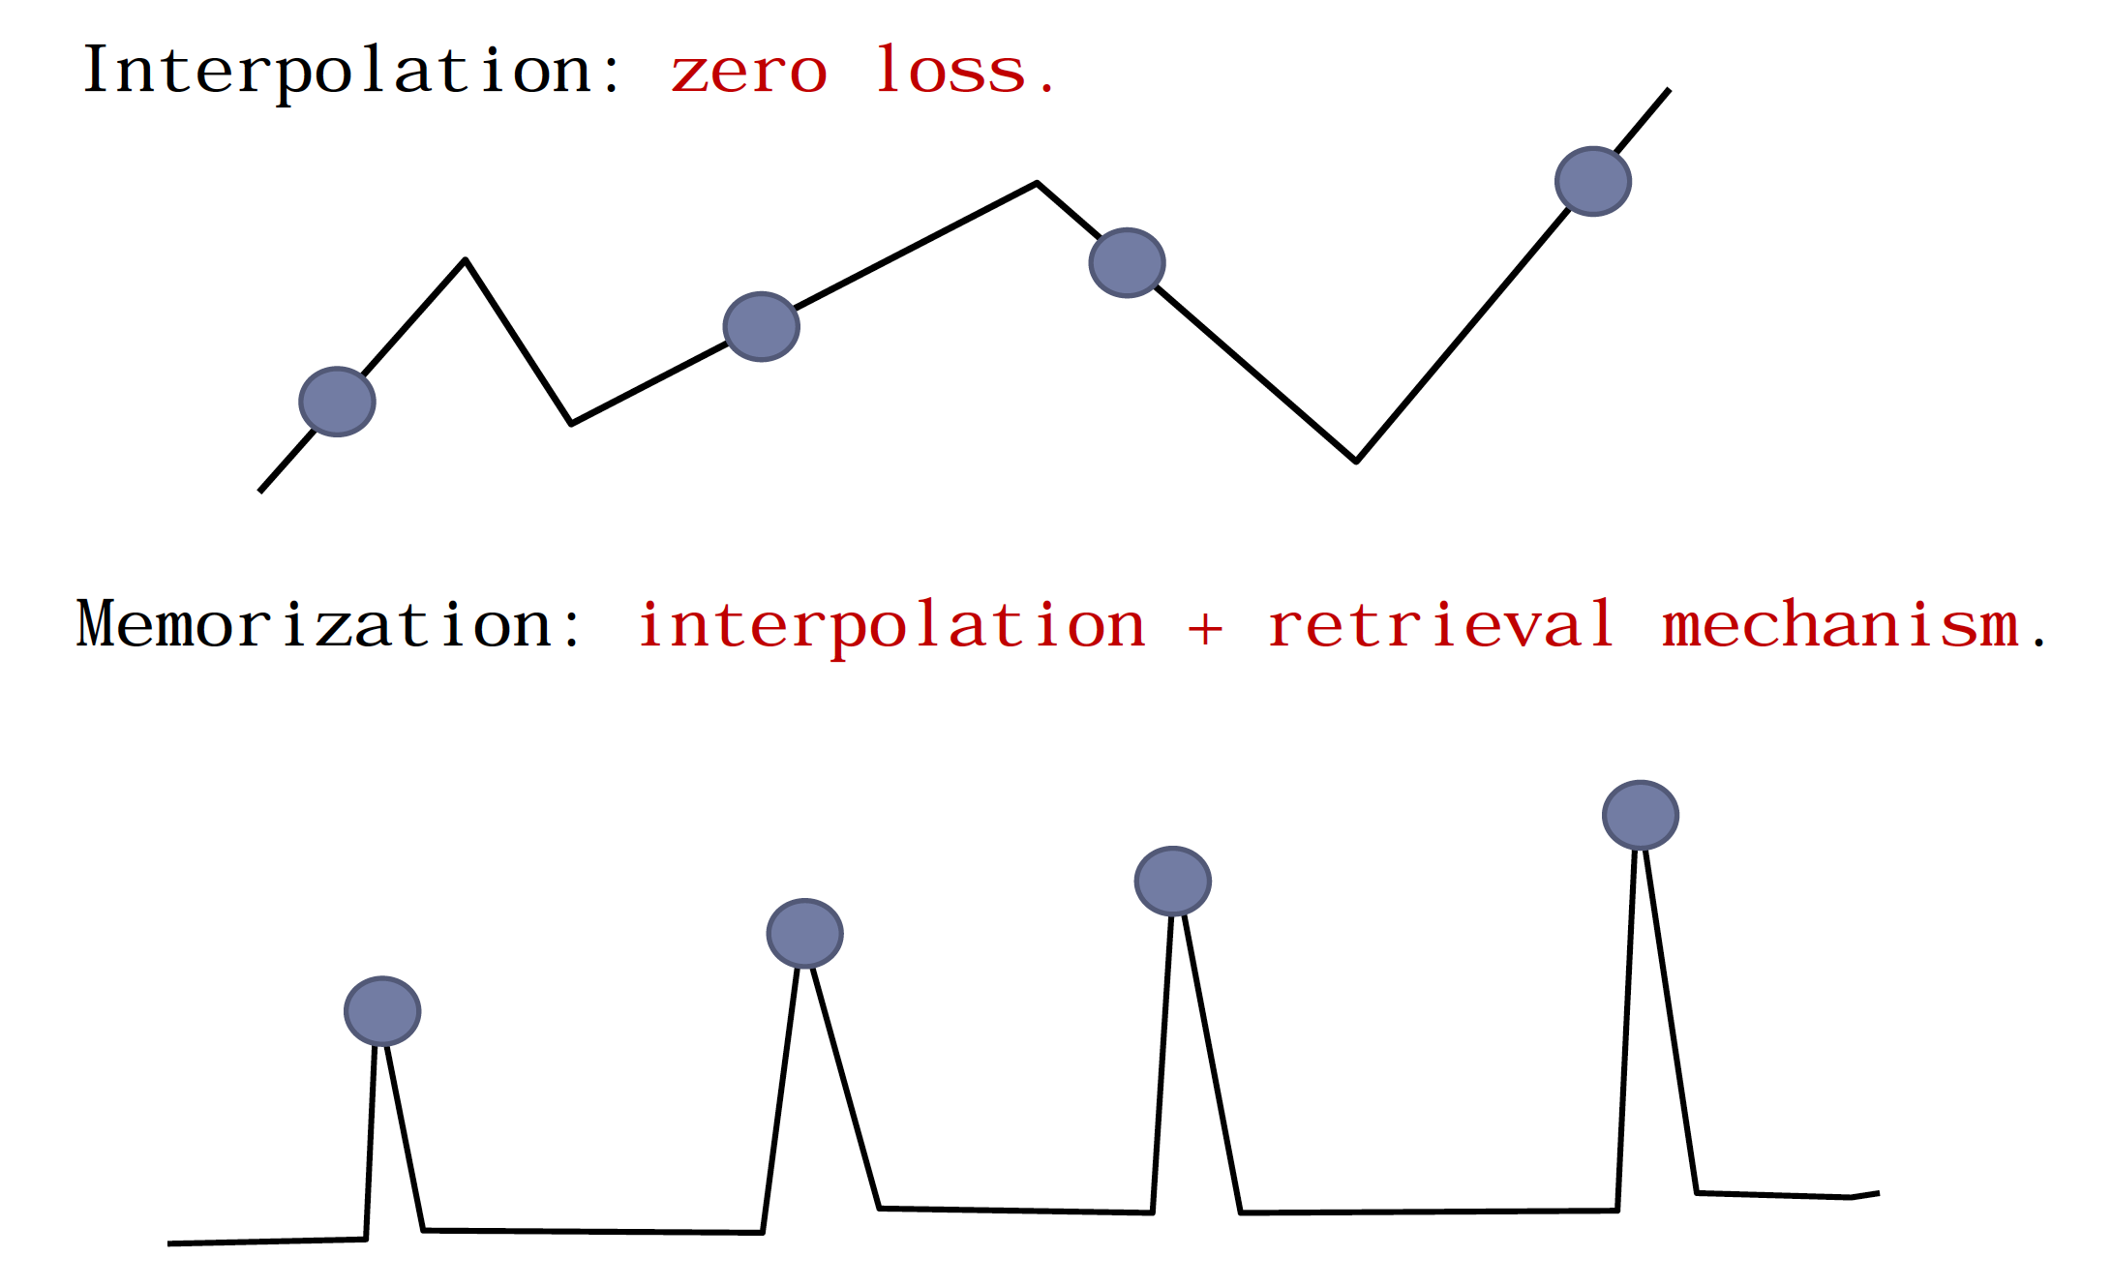
Smoothness
Difference between memorization and interpolation has to do with smoothness !

Slide 27
Ways to Increase Smoothness
Minimal norm solutions (L1, L2, frobenius norm)
Averaging: (dropout)
Other methods are boosting (Residual networks), bagging

Slide 28
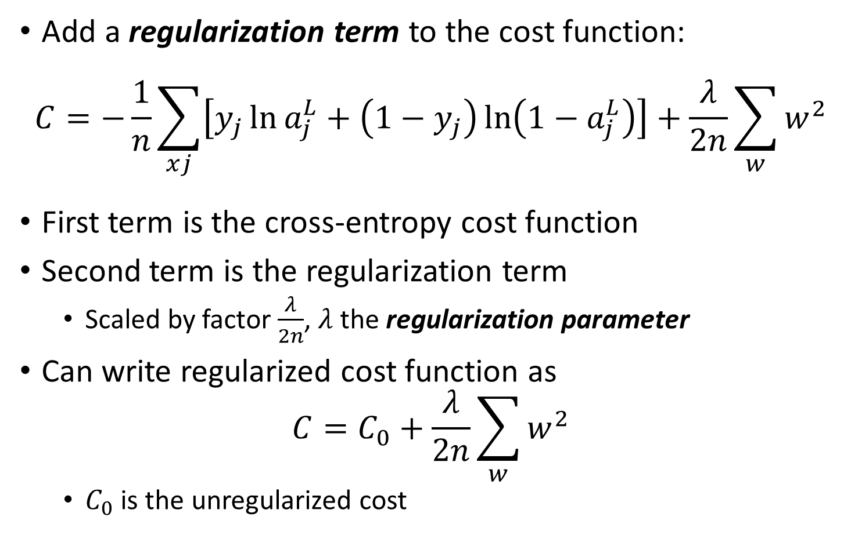
Weight decay/L2 regularization
Add a regularization term to the cost function:
$$C=−\frac{1}{n}\sum_{xj}{\left[y_{j}\ln{a_{j}^{L}}+\left(1−y_{j}\right)\ln\left(1−a_{j}^{L}\right)\right]}+\frac{λ}{2n}\sum_{w}{w^{2}}$$
First term is the cross-entropy cost function
Second term is the regularization term
Scaled by factor $\frac{λ}{2n}$, $λ$ the regularization parameter
Can write regularized cost function as
$$C=C_{0}+\frac{λ}{2n}\sum_{w}{w^{2}}$$
$C_{0}$ is the unregularized cost

Slide 29
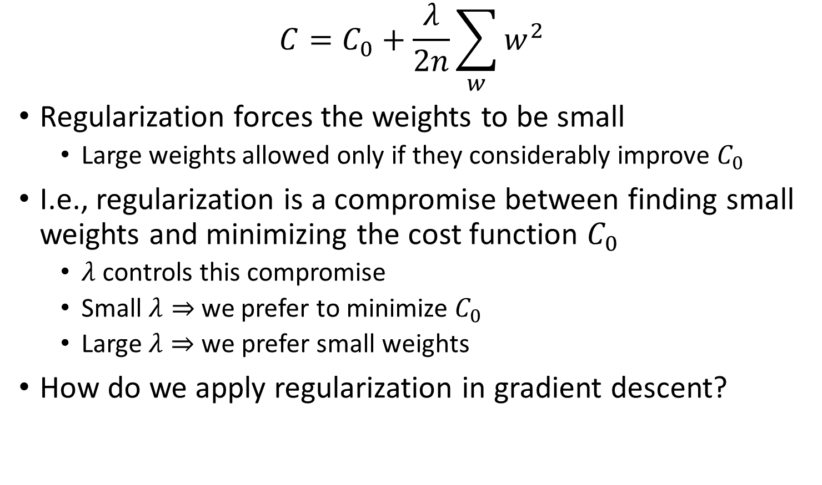
Weight decay/L2 regularization
$$C=C_{0}+\frac{λ}{2n}\sum_{w}{w^{2}}$$
Regularization forces the weights to be small
Large weights allowed only if they considerably improve $C_{0}$
I.e., regularization is a compromise between finding small weights and minimizing the cost function $C_{0}$
$λ$ controls this compromise
Small $λ⇒$ we prefer to minimize $C_{0}$
Large $λ⇒$ we prefer small weights
How do we apply regularization in gradient descent?

Slide 30
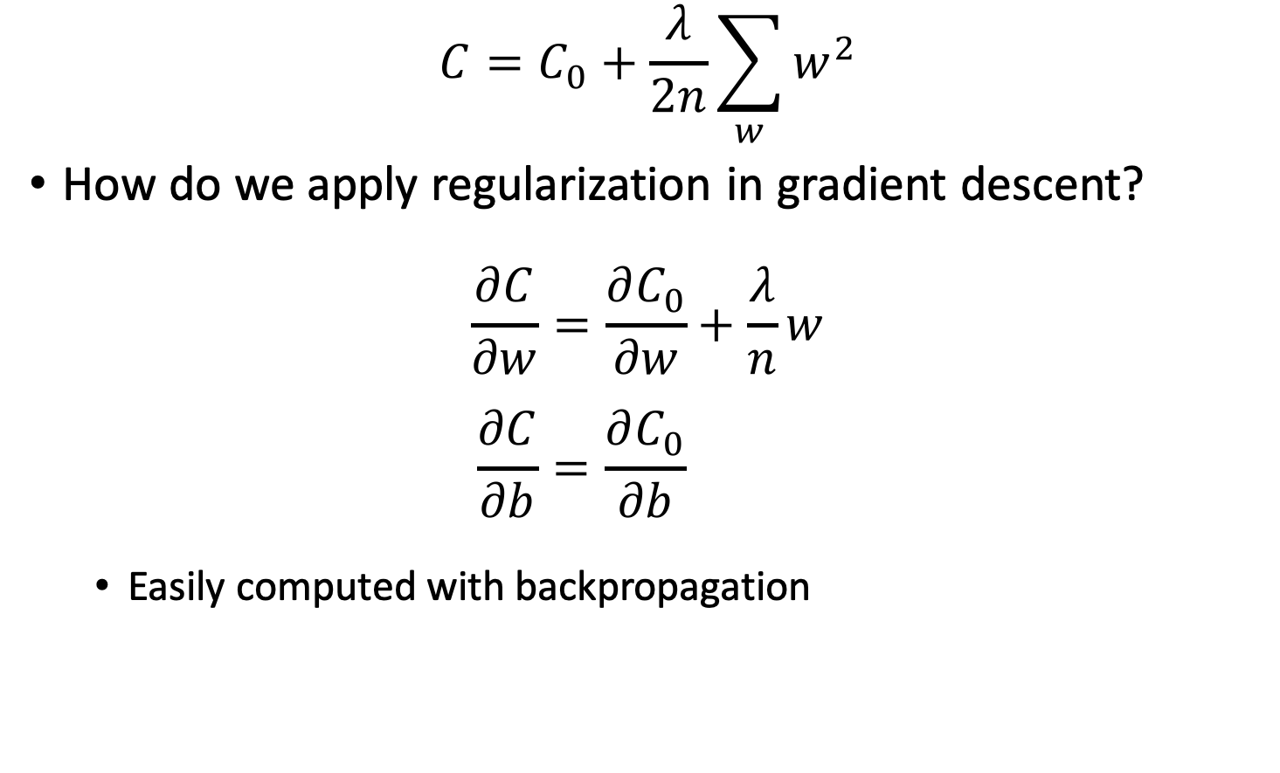
Weight decay/L2 regularization
$$C=C_{0}+\frac{λ}{2n}\sum_{w}{w^{2}}$$
How do we apply regularization in gradient descent?
$$\frac{∂C}{∂w}=\frac{∂C_{0}}{∂w}+\frac{λ}{n}w$$
$$\frac{∂C}{∂b}=\frac{∂C_{0}}{∂b}$$
Easily computed with backpropagation

Slide 31
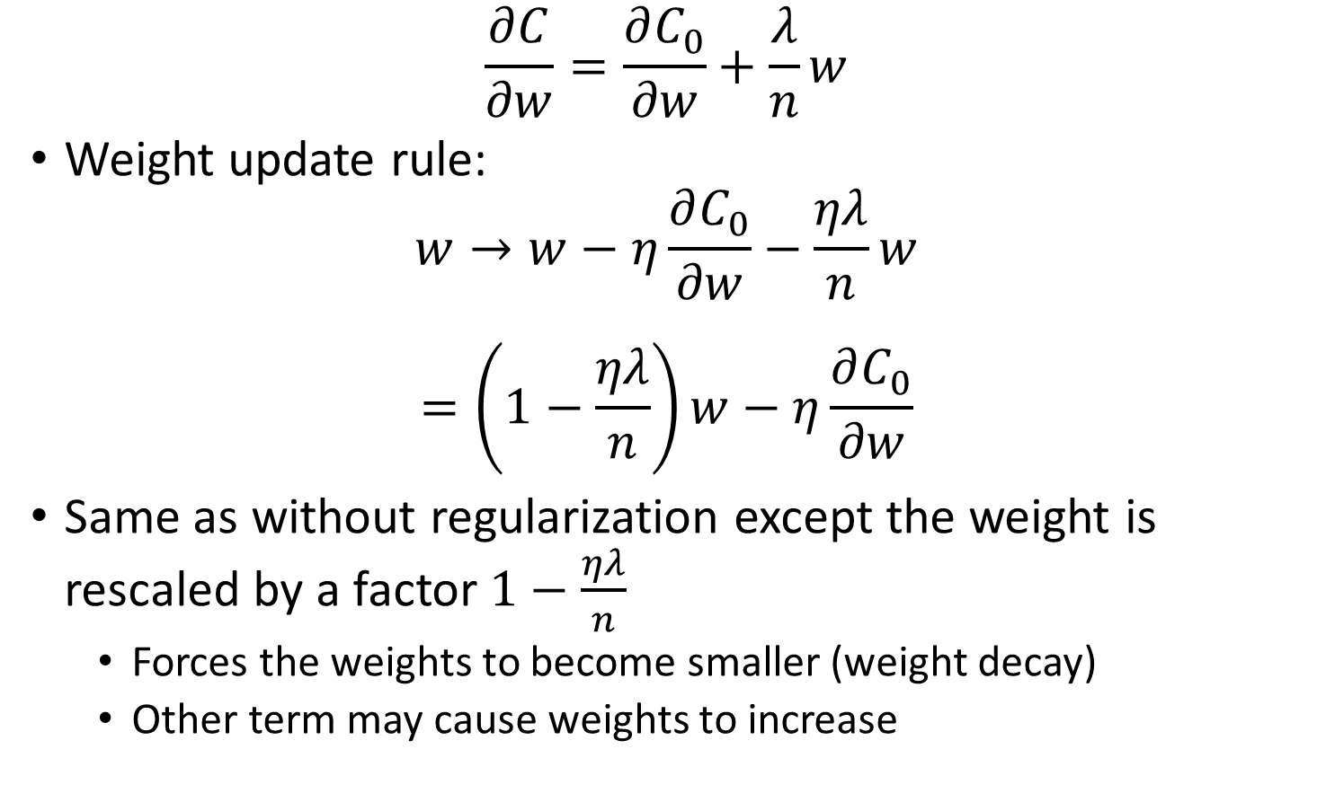
Weight decay/L2 regularization
$$\frac{∂C}{∂w}=\frac{∂C_{0}}{∂w}+\frac{λ}{n}w$$
Weight update rule:
$$w→w−η\frac{∂C_{0}}{∂w}−\frac{ηλ}{n}w$$
$$=\left(1−\frac{ηλ}{n}\right)w−η\frac{∂C_{0}}{∂w}$$
Same as without regularization except the weight is rescaled by a factor $1−\frac{ηλ}{n}$
Forces the weights to become smaller (weight decay)
Other term may cause weights to increase

Slide 32
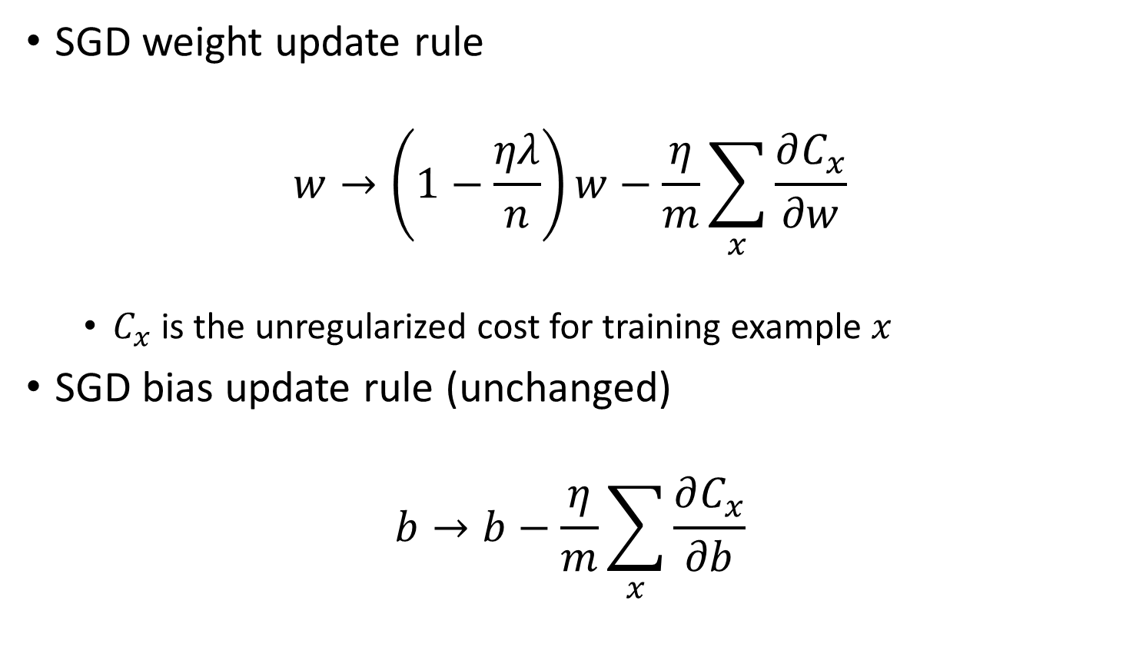
Weight decay/L2 regularization
SGD weight update rule
$$w→\left(1−\frac{ηλ}{n}\right)w−\frac{η}{m}\sum_{x}{\frac{∂C_{x}}{∂w}}$$
$C_{x}$ is the unregularized cost for training example $x$
SGD bias update rule (unchanged)
$$b→b−\frac{η}{m}\sum_{x}{\frac{∂C_{x}}{∂b}}$$

Slide 33
Weight decay/L2 regularization
Why not regularize the biases?
Empirically, regularizing the biases doesn’t seem to have much positive effect
Large biases do not make neurons sensitive to inputs in the same way as large weights
Allowing large biases gives the network some flexibility
Makes it easier for neurons to saturate which may be desirable in some cases

Slide 34
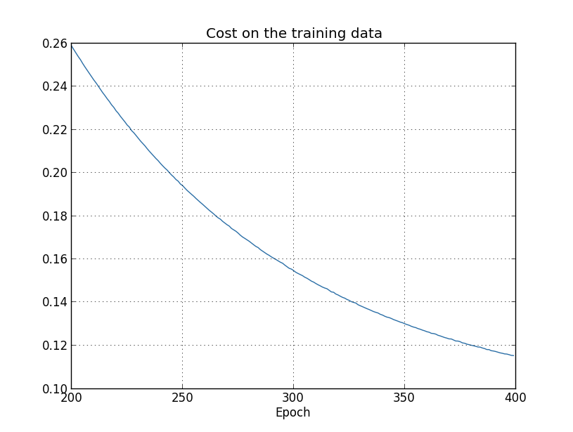
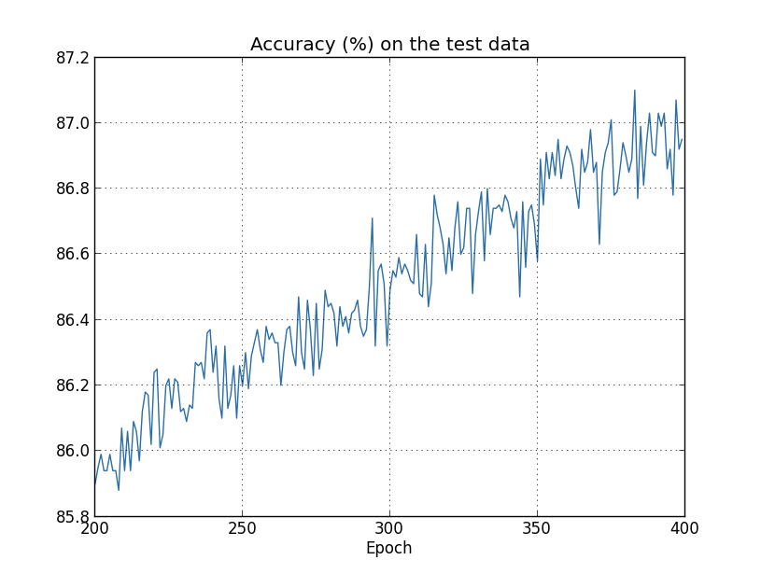
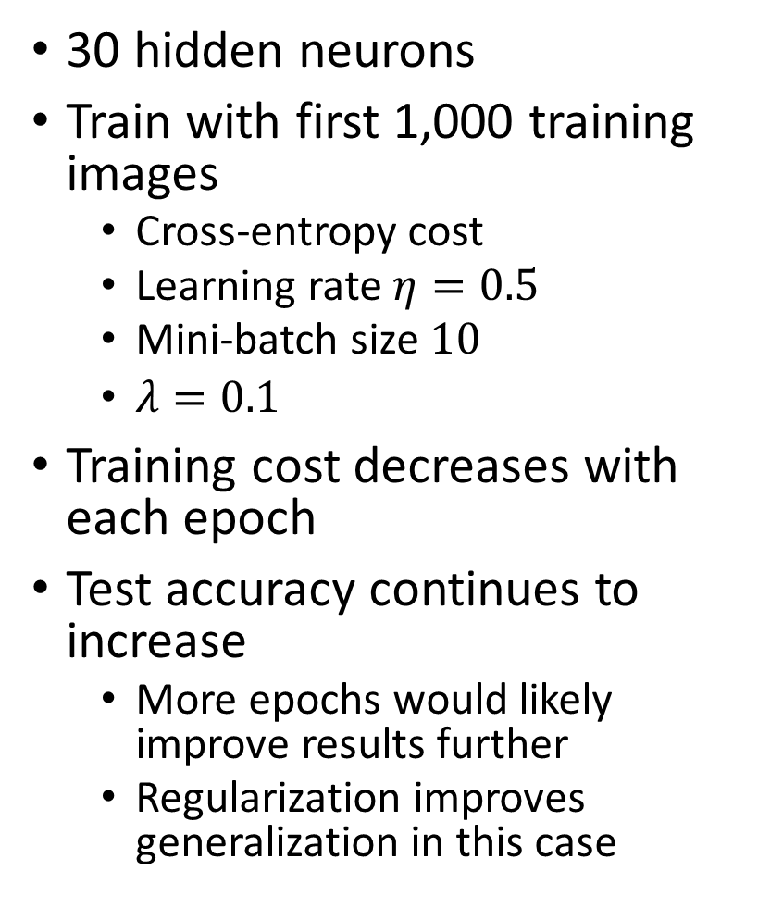
L2 regularization applied to MNIST
30 hidden neurons
Train with first 1,000 training images
Cross-entropy cost
Learning rate $η=0.5$
Mini-batch size $10$
$λ=0.1$
Training cost decreases with each epoch
Test accuracy continues to increase
More epochs would likely improve results further
Regularization improves generalization in this case
Notes:
Accuracy is 87% compared to 82.27% in the unregularized case

Slide 35
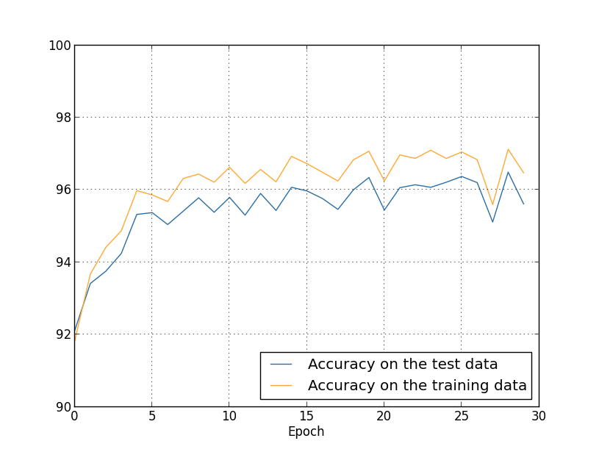
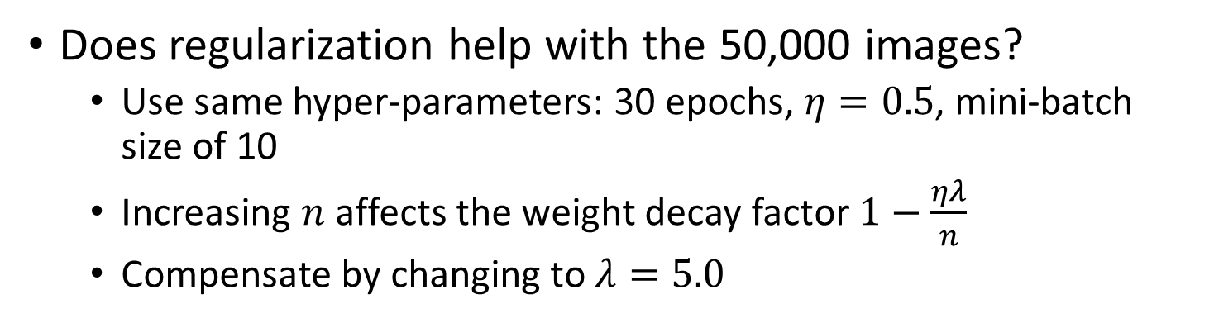
L2 regularization with more data
Does regularization help with the 50,000 images?
Use same hyper-parameters: 30 epochs, $η=0.5$, mini-batch size of 10
Increasing $n$ affects the weight decay factor $1−\frac{ηλ}{n}$
Compensate by changing to $λ=5.0$
Observations
Test accuracy w/o regularization was 95.49%
Test accuracy w/ regularization is 96.49%
Gap between test and training accuracy is narrower
Notes:
So clearly, we’ve made some progress here by including regularization

Slide 36

L2 regularization with more data
Increase # of hidden neurons to 100, set $λ=5.0$, $η=0.5$, use cross-entropy cost function, train for 30 epochs
Resulting accuracy is 97.92%
Better than 96.49% with 30 neurons
Training for 60 epochs and setting $η=0.1$ gives accuracy of 98.04%

Slide 37
Space exploration
On this data, regularized runs are much more easily replicated
Unregularized runs will sometimes get stuck in local minima under different initializations
Why is this?
Possible heuristic: without regularization, the length of the weight vector may grow very large
The weight vector is stuck pointing in the same direction (gradient descent only makes tiny changes to direction when length is long)
This may make it hard for SGD to properly explore the weight space

Slide 38

Stability of regularization
A regularized network has small weights $⇒$ the behavior of the network won’t change too much for a few random inputs
Difficult for regularized network to learn the effects of local noise
Regularized network responds to patterns seen often across the training set
A network with large weights may change its behavior drastically in response to small changes in the input

Slide 39
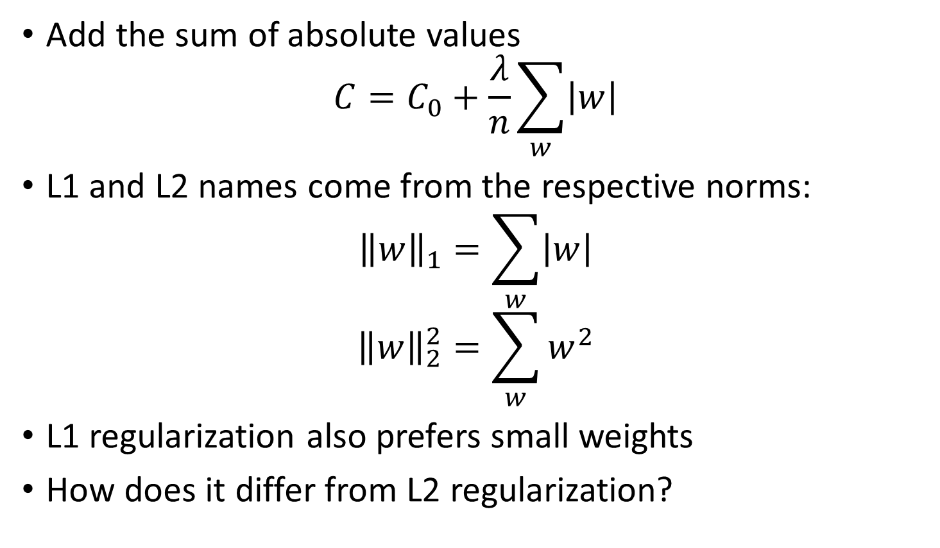
L1 regularization
Add the sum of absolute values
$$C=C_{0}+\frac{λ}{n}\sum_{w}{\left|w\right|}$$
L1 and L2 names come from the respective norms:
$${\left\|w\right\|}_{1}=\sum_{w}{\left|w\right|}$$
$${\left\|w\right\|}_{2}^{2}=\sum_{w}{w^{2}}$$
L1 regularization also prefers small weights
How does it differ from L2 regularization?

Slide 40
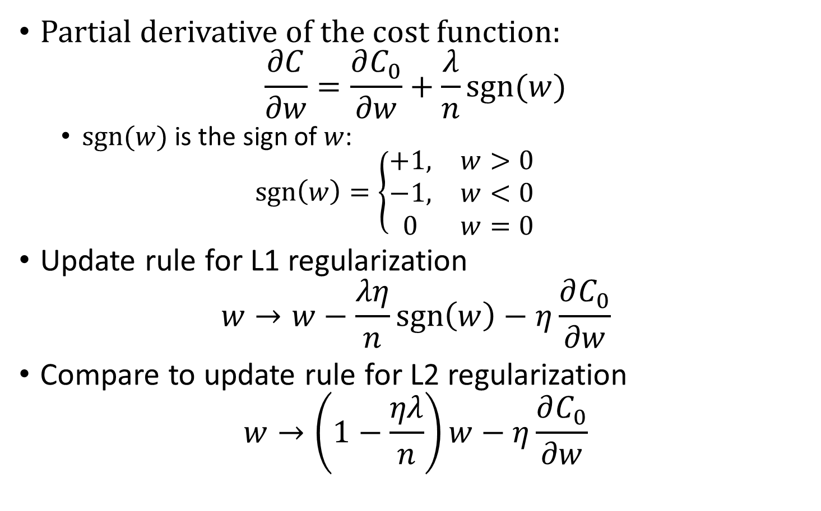
L1 regularization
Partial derivative of the cost function:
is the sign of $w$:
$$\text{sgn}\left(w\right)=\left\{\begin{aligned}+1, \\ −1, \\ 0\end{aligned} \right.\begin{matrix}w>0 \\ w<0 \\ w=0\end{matrix}$$
Update rule for L1 regularization
$$w→w−\frac{λη}{n}\text{sgn}\left(w\right)−η\frac{∂C_{0}}{∂w}$$
Compare to update rule for L2 regularization
$$w→\left(1−\frac{ηλ}{n}\right)w−η\frac{∂C_{0}}{∂w}$$

Slide 41
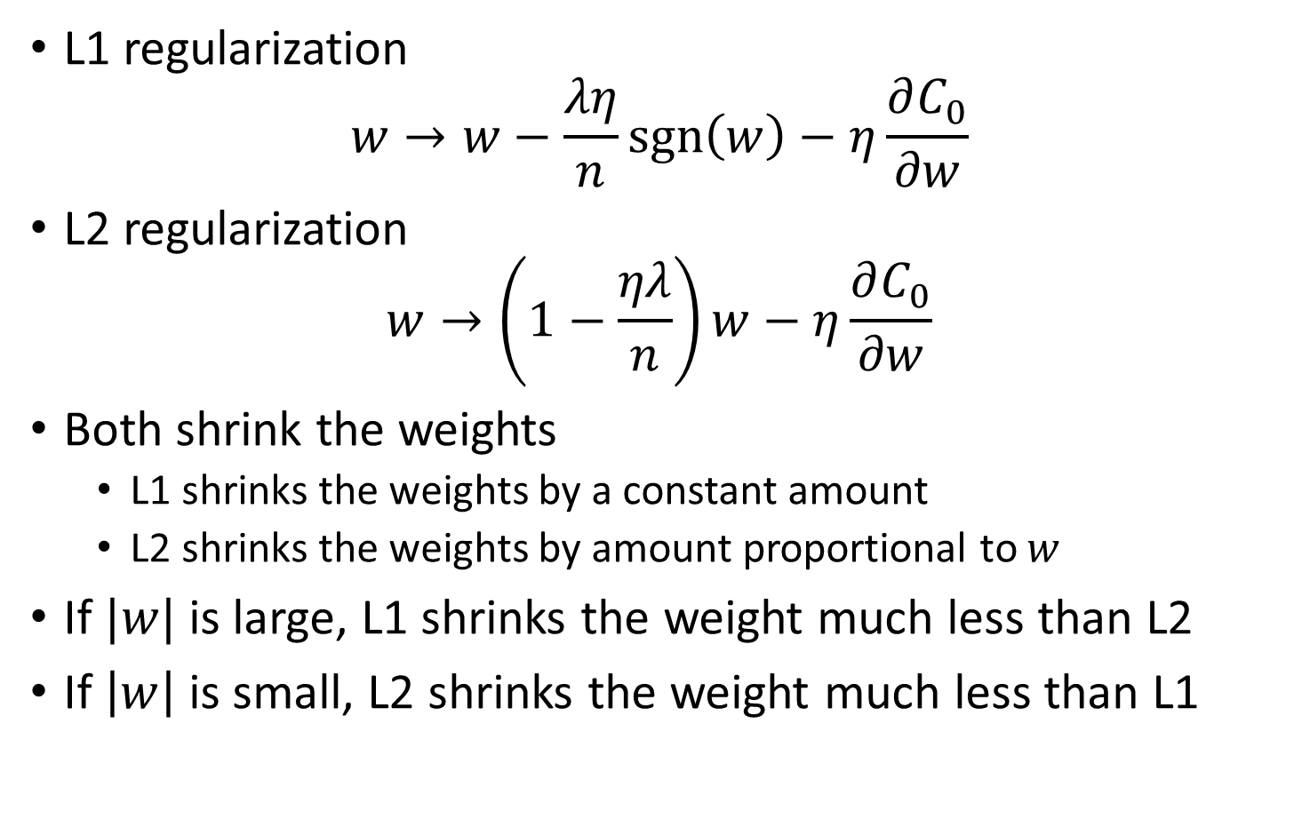
L1 regularization
L1 regularization
$$w→w−\frac{λη}{n}\text{sgn}\left(w\right)−η\frac{∂C_{0}}{∂w}$$
L2 regularization
$$w→\left(1−\frac{ηλ}{n}\right)w−η\frac{∂C_{0}}{∂w}$$
Both shrink the weights
L1 shrinks the weights by a constant amount
L2 shrinks the weights by amount proportional to $w$
If $|w|$ is large, L1 shrinks the weight much less than L2
If $\left|w\right|$ is small, L2 shrinks the weight much less than L1

Slide 42
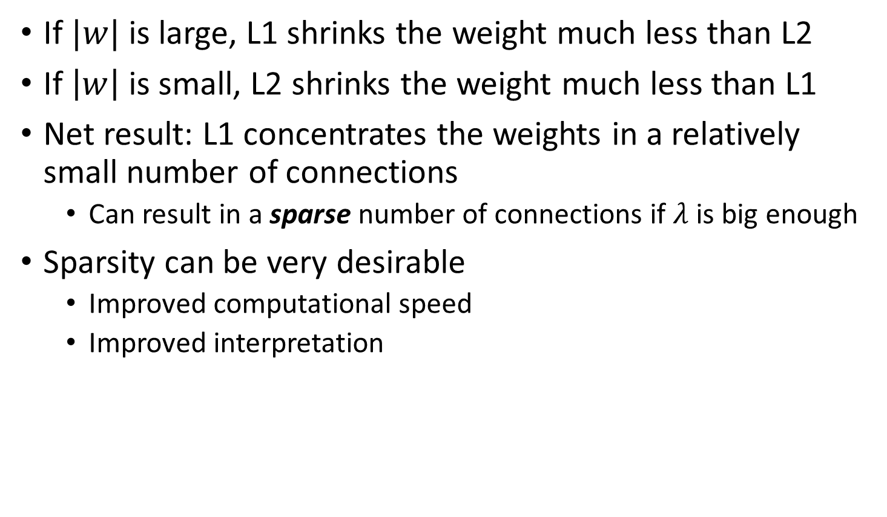
L1 regularization
If $|w|$ is large, L1 shrinks the weight much less than L2
If $\left|w\right|$ is small, L2 shrinks the weight much less than L1
Net result: L1 concentrates the weights in a relatively small number of connections
Can result in a sparse number of connections if $λ$ is big enough
Sparsity can be very desirable
Improved computational speed
Improved interpretation

Slide 43
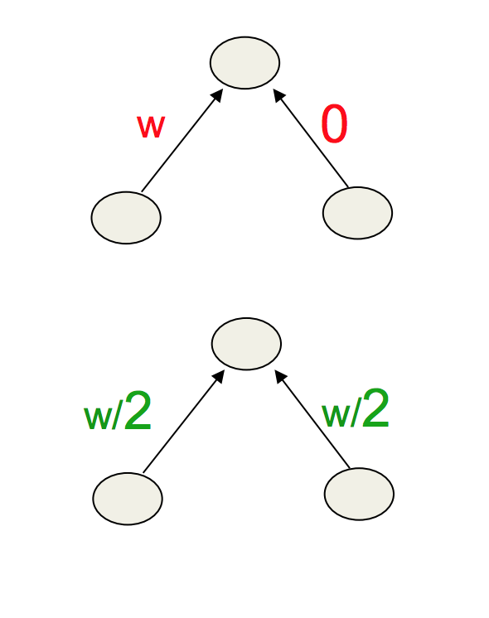
L2 Smoother Model
Prefers to share smaller weights
Makes model smoother
More Convex

Slide 44
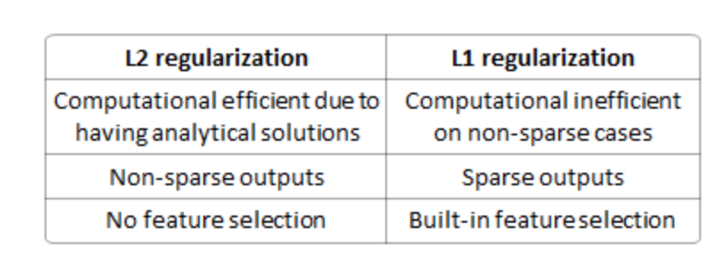
L1 vs L2

Slide 45
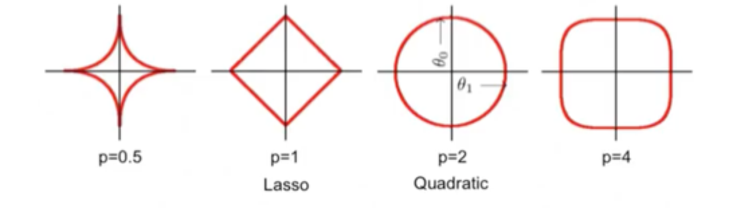
Lp Regularization
Isosurfaces
As p→0 you get a counting penalty

Slide 46
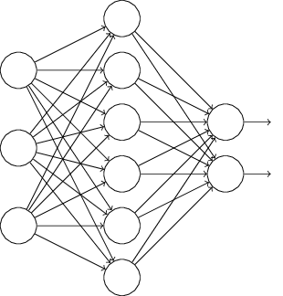

Dropout
L1 and L2 regularization directly modify the cost function
With dropout, we modify the network instead
Standard network training on input $x$ and desired output $y$
Forward propagate $x$ and then backpropagate to get gradient

Slide 47
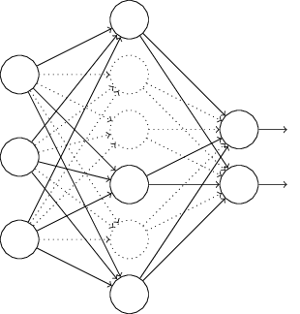

Dropout
With dropout, start by randomly and temporarily deleting half the hidden neurons
Forward propagate $x$ and backpropagate to get gradient
Update weights and biases over a mini-batch
Repeat by restoring the dropout neurons and removing a different subset

Slide 48
Dropout
Repeating this process over and over gives a set of learned weights and biases
How does this help with regularization?
Imagine we train several different neural networks using the same training data under different initializations
Different networks will overfit in different ways
We can average the results or do a majority vote
E.g., if 3/5 networks say a digit is a “3”, the other two networks are probably mistaken
Averaging over multiple networks can be a powerful (and expensive) way to reduce overfitting
Dropout is a lot like training different neural networks
Net effect of dropout generally reduces overfitting

Slide 49
Dropout
Another explanation: “This technique reduces complex co-adaptations of neurons, since a neuron cannot rely on the presence of particular other neurons. It is, therefore, forced to learn more robust features that are useful in conjunction with many different random subsets of the other neurons.” (Krizhevsky et al., 2012)
I.e., dropout is forcing the prediction model to be robust to the loss of an individual node
Somewhat similar to L1 and L2 regularization which reduce weights (making the network more robust to losing an individual connection)
Dropout also works empirically, especially when training large, deep networks

Slide 50
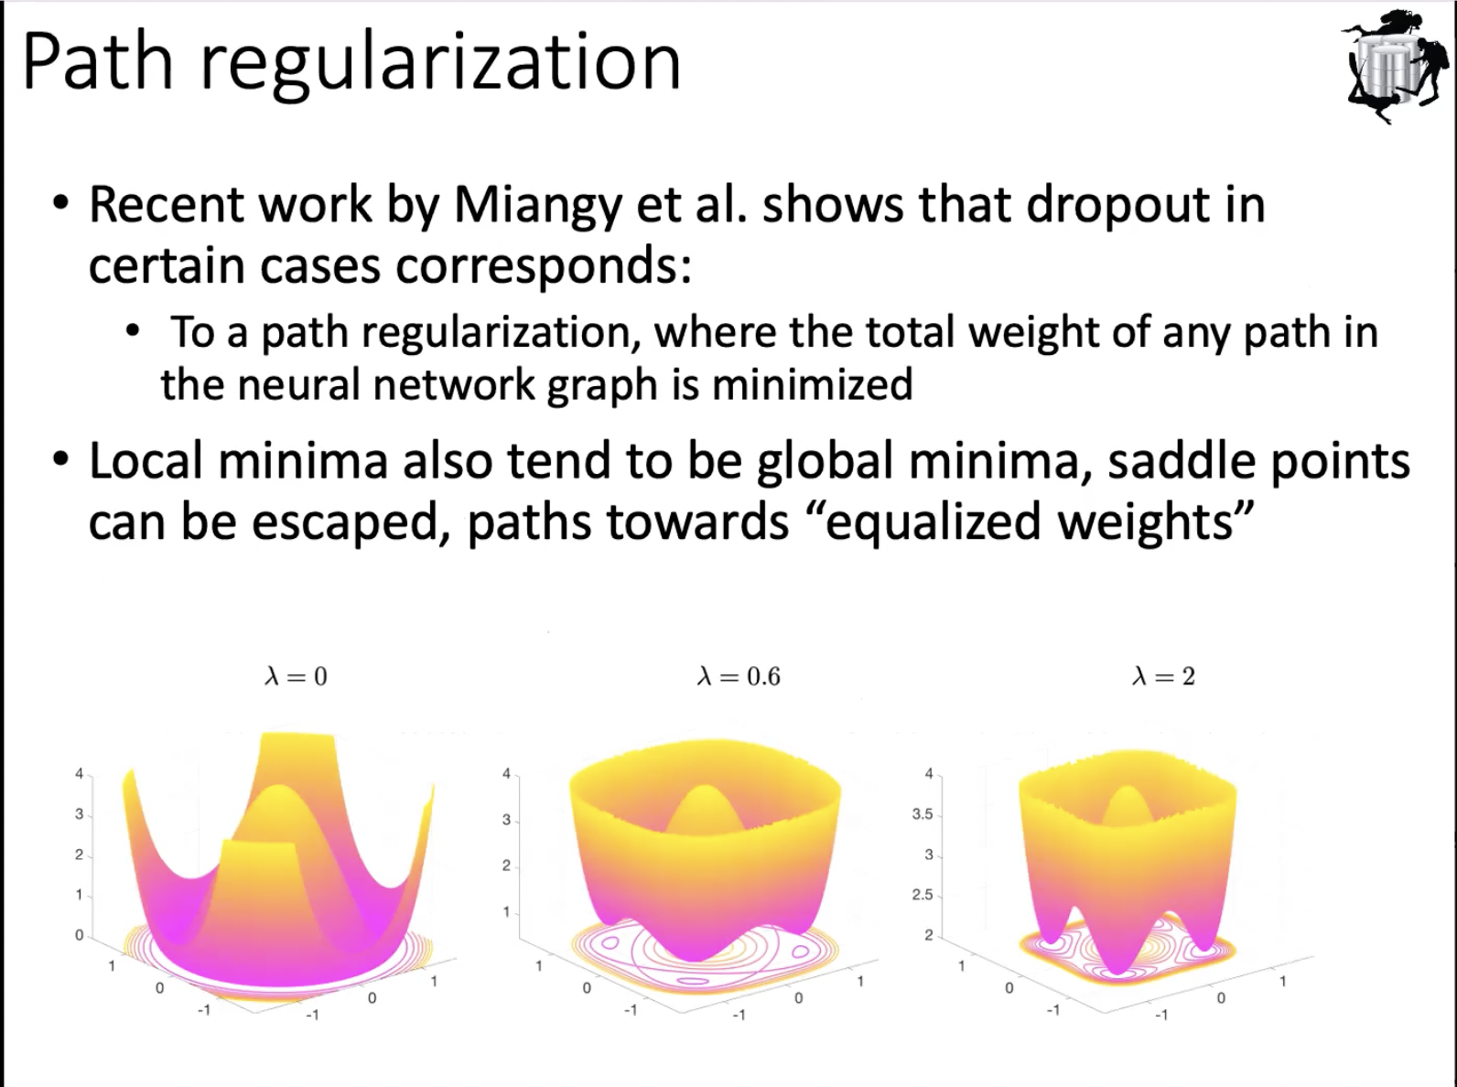

Slide 51
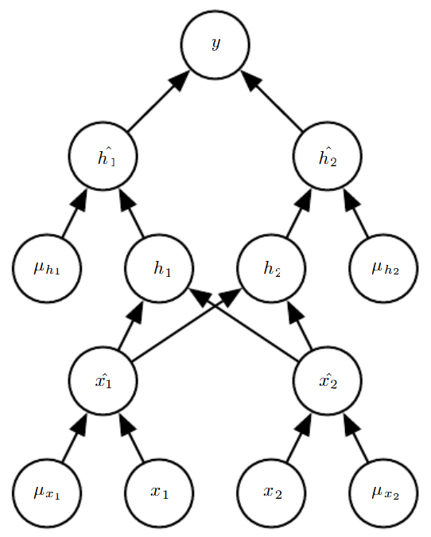
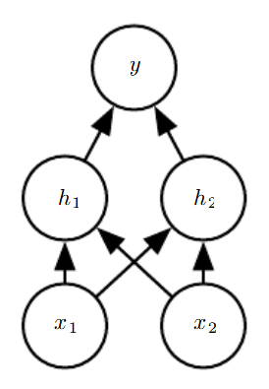

Implementing dropout
Generate a binary random vector $μ$
Probability of each entry being 1 is a hyperparameter
Multiply the output of each node with the corresponding entry in $μ$
Multiply final weights by 1/2

Slide 52
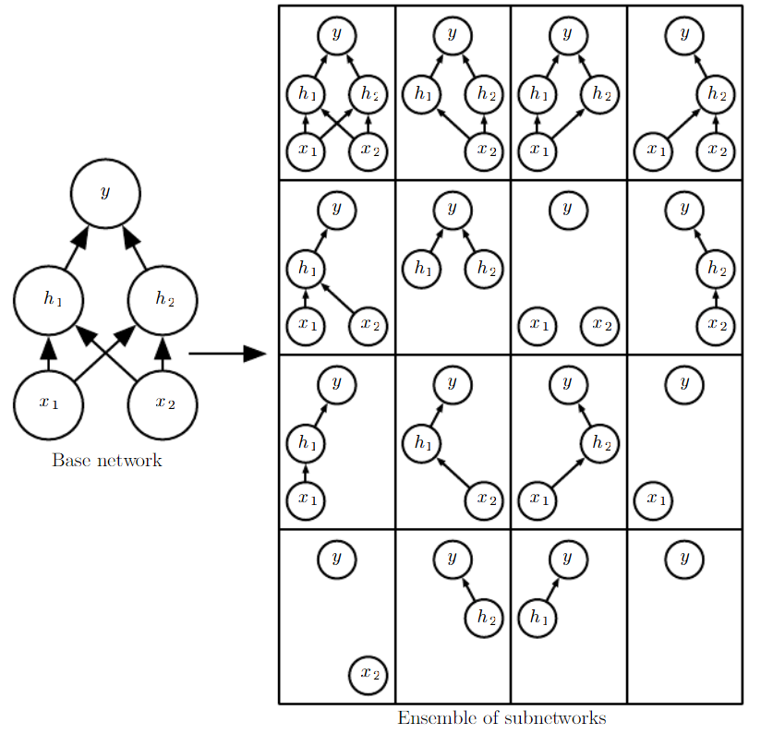
Implementing dropout
Equivalent to randomly selecting one of the following sub-networks

Slide 53
When should dropout be used?
Dropout can be applied to nearly all models
Feedforward networks, probabilistic models, RNNs, etc.
Other regularization techniques may not be applicable in these cases
For very large datasets, dropout (and regularization in general) doesn’t help much
Dropout is less effective when using very small sample sizes
See section 7.12 in the Goodfellow et al. book for more information

Slide 54
Multitask training
The same way that many datapoints can move parameters towards more generally good settings, many tasks can allow for generally good representations
Earlier works used unsupervised pretraining before supervised training

Slide 55
Summary
Overfitting is a major problem in neural networks, especially large networks
Regularization is a powerful technique for reducing overfitting
Regularization is an active area of research
Many modern architectures are based on some novel form of regularization
We will see regularization again

Slide 56
Further reading
Nielsen book, chapter 3
Goodfellow et al., chapter 7
A closer look at memorization in deep networks [Arpit et al 2017] https://arxiv.org/pdf/1706.05394.pdf
In search of the real inductive bias: on the role of implicit regularization in deep learning [Neyshabur et al, 2015] https://arxiv.org/pdf/1412.6614.pdf
On the implicit Bias of Dropout https://arxiv.org/abs/1806.09777

